Slide 1
Smart parking System
Using Arduino and Ultrasonic sensor
Name of the student | Roll Number
D. Nithya Santhoshi | AP23110020058
K.Deeksha | AP23110020064
T. Kavya | AP23110020056
Minor Project Submitted to
Dr.K.A.Sunitha
Course Code/Title:ECE308
Embedded system for design

Slide 2
Abstract
This project presents a smart parking system using Arduino and an ultrasonic sensor. The system detects a vehicle based on distance measurement and automatically opens a gate using a servo motor. After the vehicle enters, the gate closes automatically. This reduces manual effort and improves parking efficiency. The system is simple, low-cost, and suitable for small-scale applications.

Slide 3
Literature Survey
Novelty | Reference | Title | Advantages | Disadvantages
[1] | Basic Smart Parking | Sensor-based parking system | Easy to implement | Limited features
[2] | Ultrasonic System | Distance-based detection | Accurate sensing | Short range
[3] | Arduino-based | Embedded automation | Low cost | Limited scalability

Slide 4
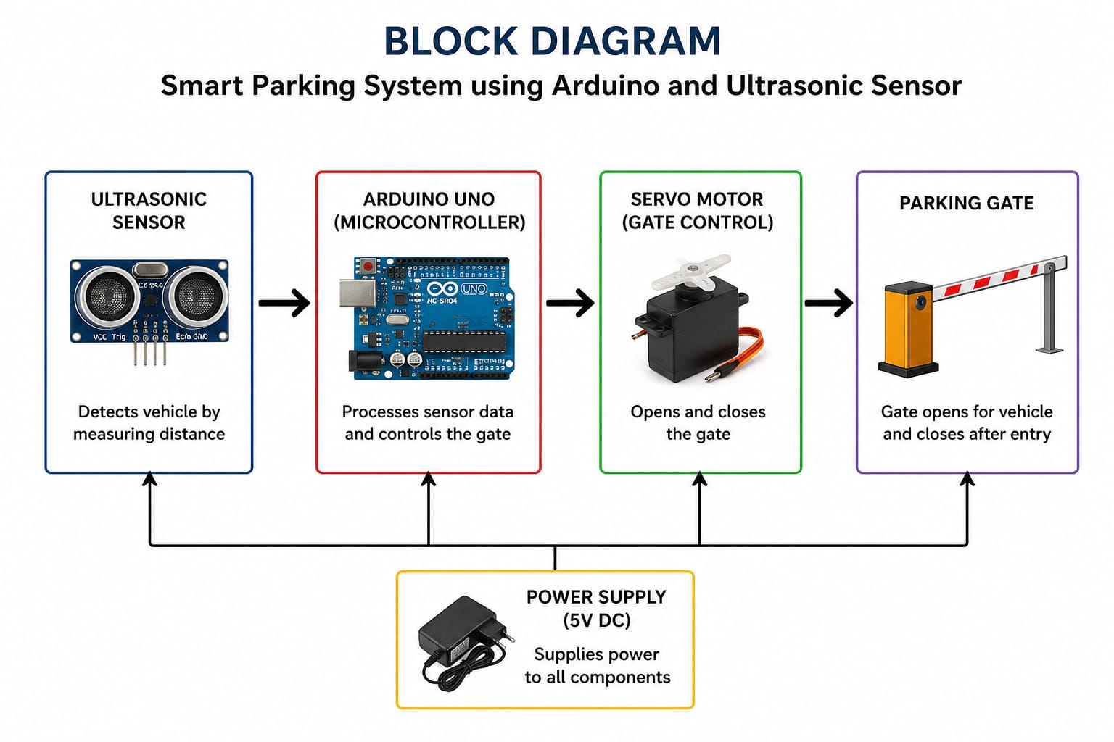
Block Diagram
The ultrasonic sensor detects a vehicle, Arduino processes the signal, and the servo motor automatically opens and closes the parking gate using power supply.

Slide 5
Aim & Objectives
AIM:
To design a smart parking system using Arduino and ultrasonic sensor.
OBJECTIVES:
Detect vehicle using ultrasonic sensor
Automate gate using servo motor
Reduce human effort
Improve parking efficiency

Slide 6
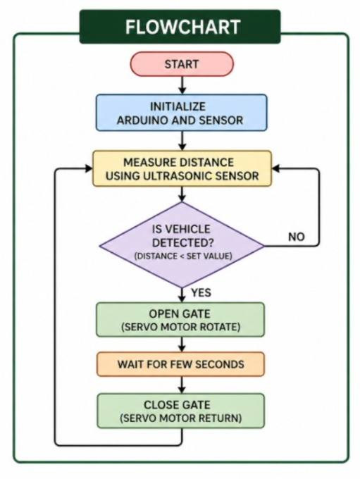
Flow Chart
The system measures distance using a sensor, and if a vehicle is detected, it opens the gate, waits, then closes it and repeats the process.

Slide 7
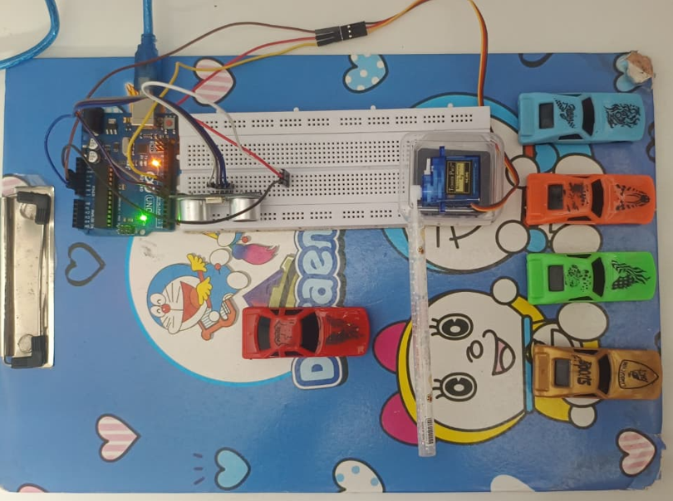
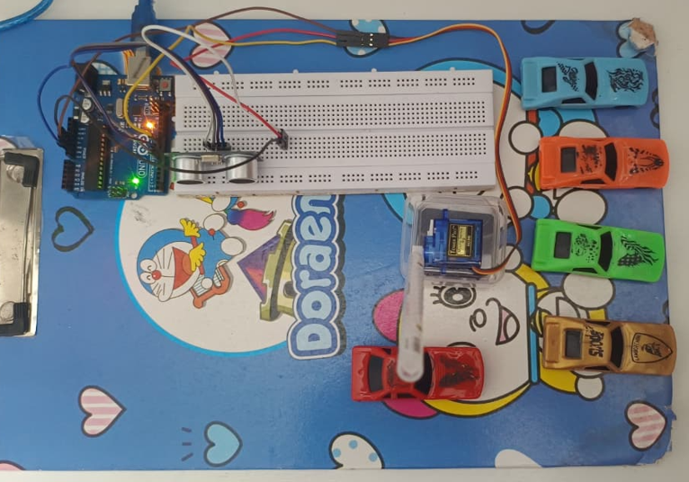
Project picture
This setup shows a real smart parking prototype where the ultrasonic sensor detects a car and the Arduino controls a servo motor to automatically open and close the gate.
This image shows the working model where the ultrasonic sensor detects the approaching car and the Arduino activates the servo motor to lift the gate, allowing the vehicle to enter automatically.

Slide 8
Budget
S.No | Component | Cost (₹)
1. | Ultrasonic sensor | 150
2. | Servomotor | 150
3. | Breadboard | 100
4. | Jumper wires | 150
5. | Power supply | 150
 | Total | 700
S.No | Component | Cost (₹)
1. | Arduino UNO | -
2. | Ultrasonic sensor | 150
3. | Servomotor | 150
4. | Breadboard | 100
5. | Jumper wires | 150
6. | Power supply | 150
 | Total | 900

Slide 9
Conclusion
The project successfully demonstrates an automatic parking system using ultrasonic sensor and Arduino. It reduces manual effort and improves efficiency. The system is cost-effective and can be enhanced with advanced features like IoT in future.

Slide 10
References
[1] Arduino, “Arduino Official Website.” [Online]. Available: https://www.arduino.cc/
[2] HC-SR04 Ultrasonic Sensor, “Ultrasonic Sensor Datasheet.”
[3] Embedded Systems, “Introduction to Embedded Systems,” Academic Notes.
[4] Smart Parking Systems, “Smart Parking System using Arduino,” International Journal of Engineering Research & Technology (IJERT).
[5] Arduino IDE, “Arduino IDE Documentation.”

